Slide 1
Sentiments Analysis
Draft 0.1

Slide 2
Sentiment Analysis
Sentiment analysis, also called opinion mining, is the field of study that analyses people’s opinions, sentiments, evaluations, appraisals, attitudes, and emotions towards entities such as products, services, organizations, individuals, issues, events, topics, and their attributes.
Positive Neutral Negative
Notes:
The process of computationally identifying and categorizing opinions expressed in a piece of text,
determine whether the writer's attitude towards a particular topic, product, etc. is positive ,negative, or neutral.

Slide 3
Sentiment Analysis
Depending on your research goal and scope choose from different data sources and methods for sentiment analysis. It can be
Surveys
Emails
Online Reviews, social media platforms, blogs, forums, news articles.
Call Center calls
Chatbots
Notes:
Most recent work has involved in extracting THE TEXTUAL INFORMATION IN THE FINANCIAL REPORTS,
As the text may contain more INFORMATION THAN THE NUMERICAL PART in an annual report
Potential Stakeholders are using Sentiment Analysis for forecasting FINANCIAL PERFORMANCE
Researchers are proposing sentiment dictionary to identify and classify the sentiment orientation in CEO letters by utilizing the appraisal theory.
Digging the main corporate social responsibility (CSR)
And forecasting financial performance.

Slide 4
Types of Sentiment Analysis
Overall Sentiment Analysis — the overall sentiment of a document/text.
Sentence Level
Document Level
Aspect-Based Sentiment Analysis(ABSA)— focusing on specific aspects - determine specifically what your customers are discussing, like product prices in online reviews, as well as the sentiments of individual customers.
Fine-grained—analyze sentiment across polarity categories (very positive, positive, neutral, negative, or very negative) to help determine customer opinions at more granular levels.
Intent—define your customers’ intent so you can understand if they’re purchasing or researching and if you’ll need to track and target later.
Notes:
The goal is to understand not only the overall sentiment of a document but also the sentiments associated with different aspects or entities mentioned within the text.
Fine Grained:
multiclass: very positive, positive, neutral, negative, or very negative
binary: Postive or Negative
Comparative Sentiment Analysis:
In comparative sentiment analysis, the focus is on understanding sentiment in relation to a specific comparison. For example, determining whether one product is preferred over another based on user reviews.
Temporal Sentiment Analysis:
Temporal sentiment analysis involves analyzing changes in sentiment over time. This can be valuable for tracking trends, monitoring public opinion, and understanding how sentiments evolve in response to events.
Cross-Domain Sentiment Analysis:
Cross-domain sentiment analysis involves building models that can generalize well across different domains or industries. It addresses the challenge of adapting sentiment analysis models to new and diverse datasets.

Slide 5
Process of Sentiment Analysis
The process of sentiment analysis follows these steps:
Transcribe Voice into Text ( if input is voice)
Breaking down the text into components : sentences, phrases, tokens, and parts of speech.
Identifying each phrase and component.
Assigning a sentiment score to each phrase with plus or minus points.
Combining scores for a final sentiment analysis.

Slide 6
Three Categories
Lexicon-Rule Based: The most straightforward sentiment analysis uses dictionaries or lexicons to explore words and phrases and determine their associated sentiments. This type of approach works well with direct and explicit opinions. While this system is fast and easy to use, it rarely considers how words are combined in a sequence. Teams need to add rules for comparative opinions as this approach can’t readily understand implicit opinions.
Machine Learning: Trains models on large datasets of labeled text to automatically learn associations between words and sentiment. Think of an AI learning from labeled examples.
Hybrid: Combining both rule-based and automated systems means you can gain the accuracy and precision you need to truly understand your customers. This is the most powerful system as it contains the emotional information gathered from lexicons, which can be adapted over time.

Slide 7
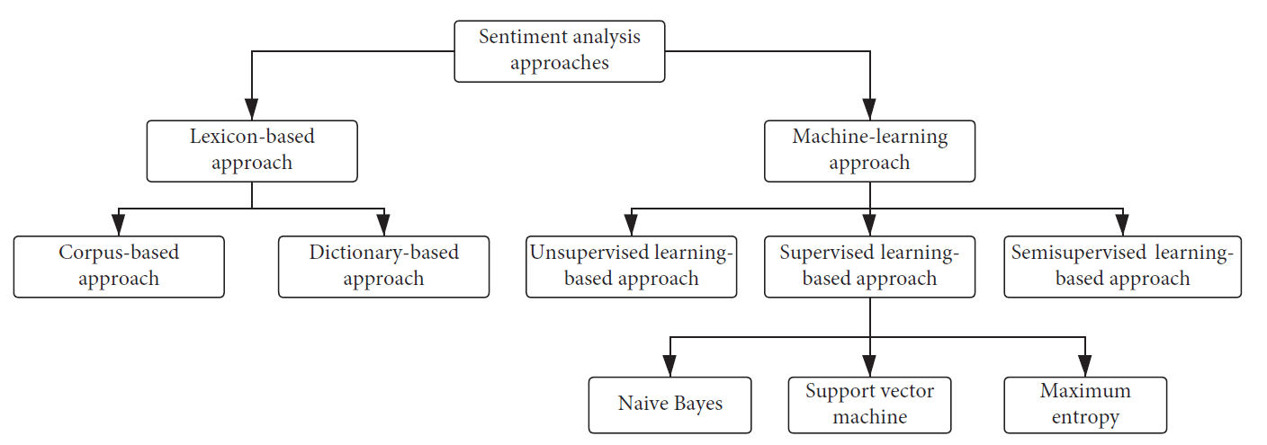
Lexicon Based vs Machine Learning
Notes:
A large collection of written or spoken text data used for linguistic analysis, statistical modeling, and training language models.
Examples: Books, articles, social media posts, transcripts, emails, etc.
Definition: A dictionary or list of words and their associated information, such as:
Meaning: Definitions, synonyms, antonyms.
Grammatical properties: Part-of-speech, conjugation, declension.
Sentiment: Positive, negative, neutral.
Domain specificity: Technical terms, slang, regional vocabulary.

Slide 8
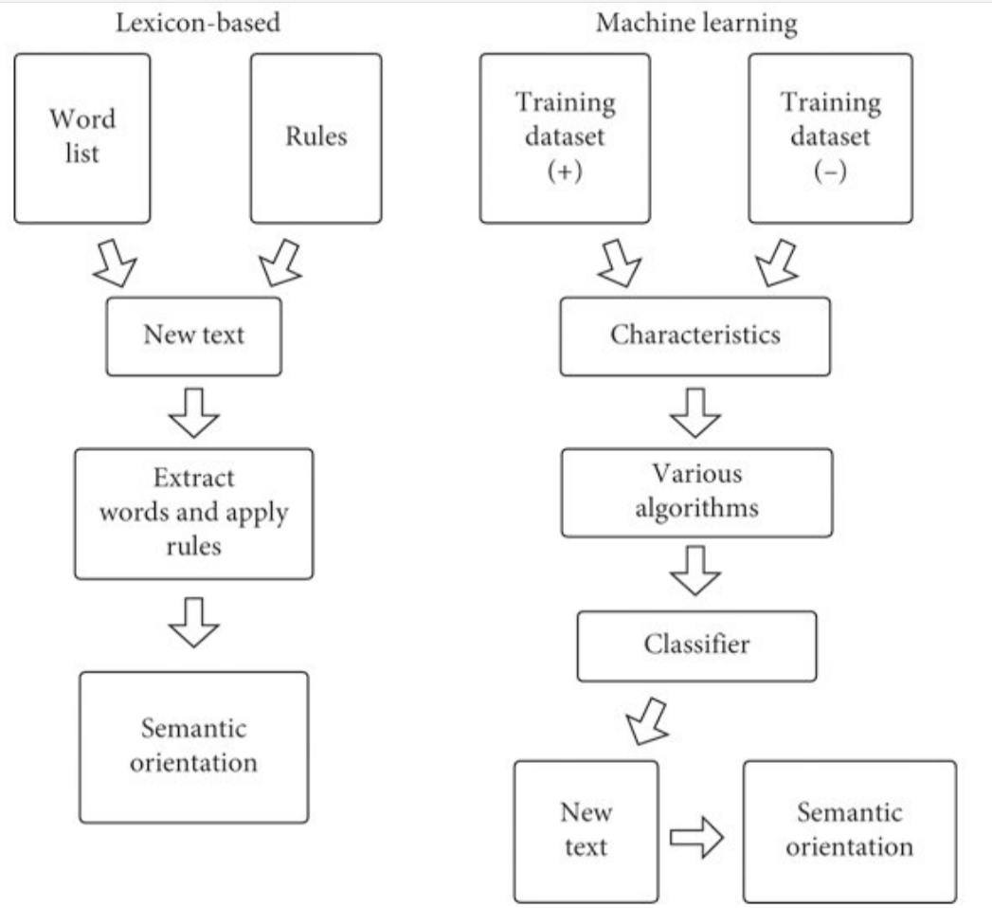
Lexicon Based vs Machine Learning
Various Classification Algorithms
Naive Bayes
Support Vector Machine (SVM)
Logistic Regression
…
Neural Networks
RNN(BiLSTM, …)
CNN
Transformers
Notes:
Factors to consider when choosing an algorithm:
Size and quality of dataset: Larger datasets often benefit from deep learning models.
Complexity of sentiment task: Simple tasks (e.g., polarity detection) may be well-suited for Naive Bayes or logistic regression, while more complex tasks (e.g., aspect-based sentiment analysis) may require SVM or deep learning models.
Interpretability requirements: If understanding the reasoning behind sentiment predictions is important, Naive Bayes, logistic regression, or decision trees may be preferable.
Computational resources: Deep learning models often require more computational power and time to train

Slide 9
Sentiment Analysis Models
Lexicon-rule based models
Vader
TextBlob
Machine Learning
Supervised
DistilBert (Transformers)
Hybrid
Semi-supervised
Flair (RNN)
BERT-WMAL*
* Not part of POC
Notes:
Valence Aware Dictionary and sEntiment Reasoner
Flair is considered hybrid it semi-supervised

Slide 10
VADER
VADER (Valence Aware Dictionary and sEntiment Reasoner) is a lexicon and rule-based sentiment analysis tool that is specifically designed to handle social media texts.
It uses a sentiment lexicon that is trained on social media data, 7500+ words and phrases each assigned a sentiment intensity score (-4 to +4) based on human ratings and linguistic rules.
Includes common slang, emojis, emoticons, and abbreviations often used in social media text.
Notes:
>>"lexicon" refers to the vocabulary or set of words
The algorithm behind VADER is a rule-based approach that combines a pre-built lexicon with a set of grammatical and syntactical rules. The lexicon contains words with associated sentiment scores, indicating how positive, negative, or neutral each word is. The lexicon is enhanced with features to handle aspects such as negation, capitalization, and intensity.

Slide 11
VADER - Rule-Based Heuristics:
Punctuation: Adjusts sentiment scores based on exclamation marks, question marks, etc.
Capitalization: Considers all caps words as more intense.
Negation: Reverses sentiment using words like "not," "never."
Intensifiers: Increases intensity with words like "very," "extremely."
Conjunctions: Handles sentiment shifts with words like "but," "although."
Other rules: Addresses emoticons, emojis, repeated punctuation etc.

Slide 12
Vader-Lexicon Based
Lexicon Based Sentiment Analysis
A big dictionary where each word is labeled with a sentiment, e.g.
Happy Emotions-(Positive):
Positive emotions: joy, love, excitement, delight, thrilled, grateful, amused, optimistic, proud
Sensory words: beautiful, delicious, vibrant, soft, cozy, refreshing, radiant
Actions: celebrate, succeed, achieve, explore, create, help, inspire, share
Happy Emotions-(Negative):
Negative emotions: sadness, anger, fear, disappointment, frustration, boredom, disgust, anxiety
Descriptive words: dark, bleak, cold, harsh, rough, bitter, messy, broken
Actions: cry, struggle, fail, worry, blame, doubt, avoid, withdraw
Neutral Emotions-(Neutral):
Neutral words: thing, fact, situation, information, objective, data, circumstance, detail
Verbs: happen, occur, exist, remain, continue, develop, evolve, seem
Notes:
For example, "awesome" usually has a happy face sticker, but in a sarcastic context, it might switch to a blank or even a sad face. Likewise, a word like "cold" could be neutral when describing the weather, but negative when applied to a person's personality.
The key is to use a rich and diverse dictionary with clear definitions and sentiment labels, and then to apply it carefully while considering the surrounding context. This can help you get a good starting point for understanding the overall sentiment of a text, even if it's not always perfect.

Slide 13
Vader-Rules Based
Rules: These are your pre-defined rules for identifying sentiment cues. They can be based on things like:
Negation: Words like "not," "never," "hardly" can reverse the sentiment of a sentence.
Intensity: "Very," "really," "extremely" can amplify the sentiment.
Comparisons: "Better than," "worse than" indicate relative sentiment.
Figurative language: Sarcasm, metaphors, and irony can be tricky, but rules can help identify them.
Sentence Analyzer: This scans the text, checking for patterns that match the rules.
Sentiment Judge: Based on the matched rules, the analyzer assigns a sentiment score to the sentence.

Slide 14
Flair
Flair is a powerful NLP library that allows you to apply state-of-the-art natural language processing (NLP) models to your text, such as named entity recognition (NER), sentiment analysis, part-of-speech tagging (PoS), special support for biomedical data, sense disambiguation and classification, with support for a rapidly growing number of languages.
Flair's sentiment analysis model utilizes a stacked bidirectional LSTM (BiLSTM) architecture extension of recurrent neural network (RNN) architecture.
Notes:
* Flair's sentiment analysis model utilizes a stacked bidirectional LSTM (BiLSTM) architecture extension of recurrent neural network (RNN) architecture.
* Character Embeddings: representing each character in a word as an embedding vector
* Bidirectional LSTM Layers: Flair employs multiple layers of bidirectional LSTMs. Bidirectional LSTMs process input sequences in both forward and backward directions, capturing contextual information effectively.
* Hidden States: The hidden states generated by the BiLSTM layers contain information about the context of each character in the input sequence, allowing the model to understand the relationships between characters and words.
* Training: The model is trained using labeled data, where the weights of the network are adjusted to minimize the difference between predicted sentiment scores and the ground truth labels.

Slide 15
Flair
Each character in a word as an embedding vector (Character Embeddings)
Flair employs multiple layers of bidirectional LSTMs.
Bidirectional LSTMs process input sequences in both forward and backward directions, capturing contextual information effectively.
The hidden states generated by the BiLSTM layers contain information about the context of each character in the input sequence, allowing the model to understand the relationships between characters and words.
The model is trained using labeled data, where the weights of the network are adjusted to minimize the difference between predicted sentiment scores and the ground truth labels. (Training)

Slide 16
TEXTBLOB
TextBlob is not a pure Rule-based Sentiment Analysis.It uses a rule-based approach and a machine learning model to analyze text data.
Naive Bayes Classifier: This is the default method used by TextBlob. It involves a statistical model that analyzes the probability of a sentence belonging to a specific sentiment category (positive, negative, or neutral) based on the presence of individual words.
TEXTBLOB returns ( Polarity and Subjectivity)::
Polarity is a float that lies between [-1,1], -1 indicates negative sentiment and +1 indicates positive sentiments.
Subjectivity is also a float that lies in the range of [0,1]. Subjective sentences generally refer to opinion, emotion, or judgment.
Notes:
Naive Bayes Classifier: This is the default method used by TextBlob. It involves a statistical model that analyzes the probability of a sentence belonging to a specific sentiment category (positive, negative, or neutral) based on the presence of individual words.

Slide 17
Various results sample tests shows following results
Vader
Analysis responses are quite extreme in both ends, potentially due to the way the compound scores are calculated. Vader was made to be distinct in its answer.
Flair Both cases (positivity and negativity) were not nearly as extreme as Vader, possibly owing to its emphasis on context awareness, and using the entire text throughout its analysis.
Flair
TextBlob struggled completely to provide a significant polarity, despite the pre-processing
For Details see here (https://aashishmehta.com/sentiment-analysis-comparison/)
Notes:
Vader vs Flair vs TextBlob - Sentiment Analysis Comparison (aashishmehta.com)

Slide 19
References
Anticipating Corporate Financial Performance from CEO Letters, Siqi Che¹, Wenzhong Zhu² ,and Xuepei Li³
Utilizing Sentiment Analysis
Vader vs Flair vs TextBlob - Sentiment Analysis Comparison
https://aashishmehta.com/sentiment-analysis-comparison/
What is sentiment analysis and opinion mining in Azure Cognitive Service for Language? - Azure Cognitive Services | Microsoft Learn
Use the sentiment analysis prebuilt model in Power Automate - AI Builder | Microsoft Learn
AI Builder documentation | Microsoft Learn
What Is a CDP | Microsoft Dynamics 365
Sentiment Analysis in Python: TextBlob vs Vader Sentiment vs Flair vs Building It From Scratch (neptune.ai)

